Slide 1
IMAGE STENOGRAPHY Application
CAPSTONE PROJECT
Presented By: Jaya Sri Neerukattu
Student Name : Jaya Sri Neerukattu
College Name & Department : NRI INSTITUTE OF TECHNOLOGY & Electronics and communication Department

Slide 2
OUTLINE
Problem Statement
Technology used
Wow factor
End users
Result
Conclusion
Git-hub Link
Future scope

Slide 3
Problem Statement
Our data is very critical in the world we live in today. Conventional encryption methods are very vulnerable to detection and interception. This has led to the development of a more covert means of communications which conceals the very presence of a text. Image steganography offers a unique approach by embedding the hidden message in images, which makes it difficult for unauthorized recipients to realize the occurrence of confidential data.

Slide 4
Technology used
Python: Core programming language for building the application.
Python modules used:
OpenCV: Utilized for image processing and manipulation.
Streamlit: Used for creating an interactive and user-friendly web interface.
ASCII Mapping: Converts characters to ASCII values for embedding in image pixels.
NumPy: Facilitates efficient array operations and pixel manipulation.

Slide 5
Wow factors
Invisible Messaging: The encoded image appears visually identical to the original, maintaining secrecy.
Interactive UI: User-friendly interface built with Streamlit, ensuring ease of use for both encoding and decoding.
Cross-Platform Accessibility: As a web-based app, it can be accessed from any device with a browser.
Secure Communication: The use of a passcode for decoding adds an additional layer of security.
No Quality Loss: The image quality remains unchanged, preserving the cover image's integrity.

Slide 6
End users
Journalists and Activists: For securely communicating sensitive information without detection.
Corporate Professionals: To protect confidential business data and communications.
General Users: Anyone seeking private communication without raising suspicion.
Educational Purposes: Students and educators in cybersecurity and cryptography fields for learning and demonstration.

Slide 7
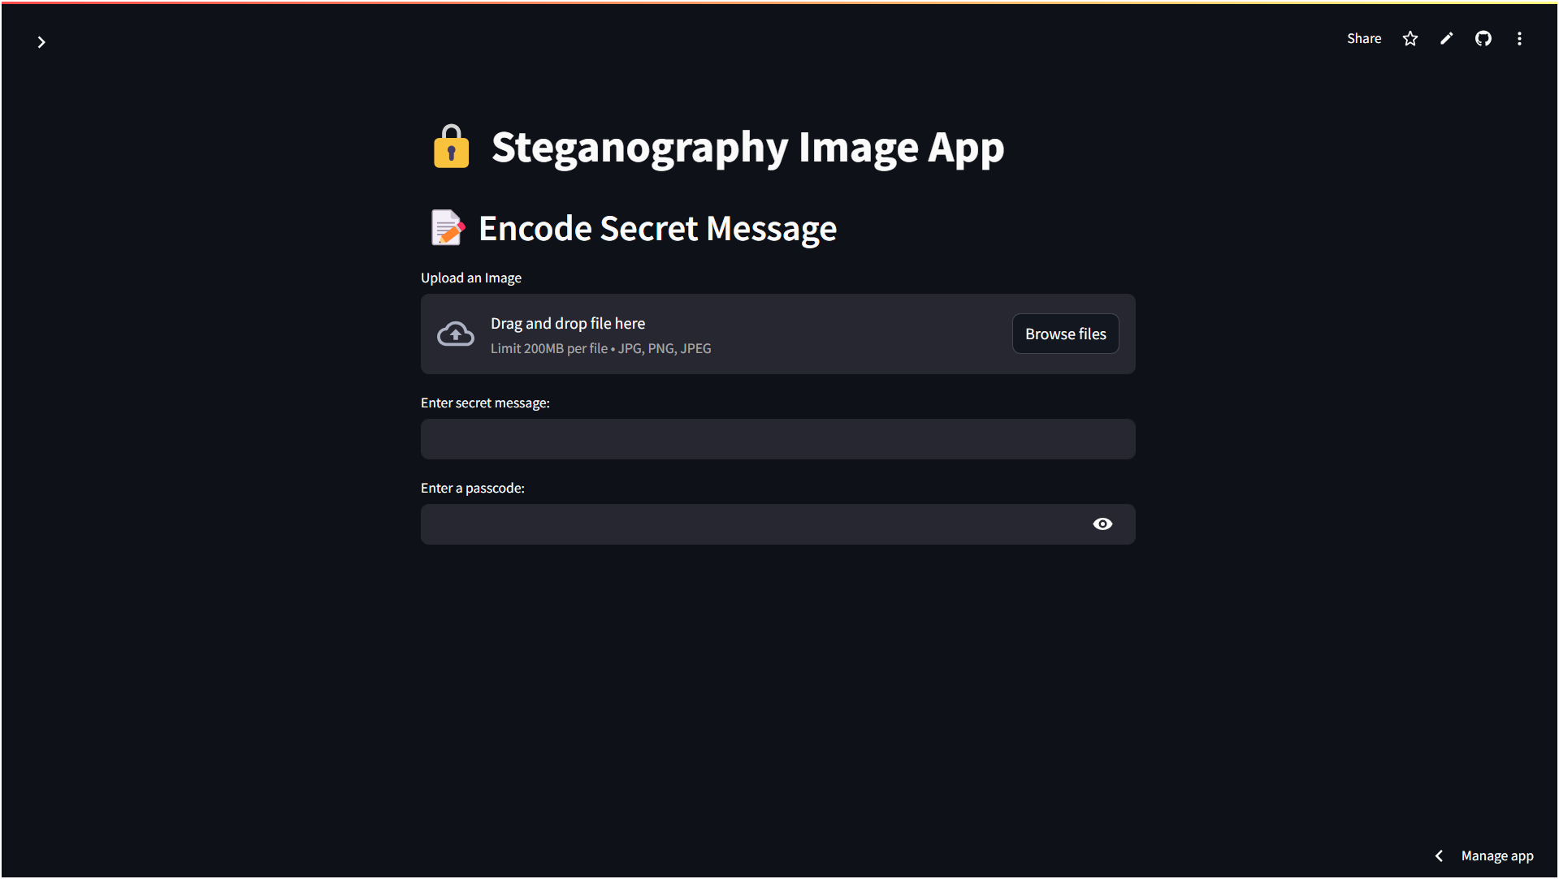
Results

Slide 8
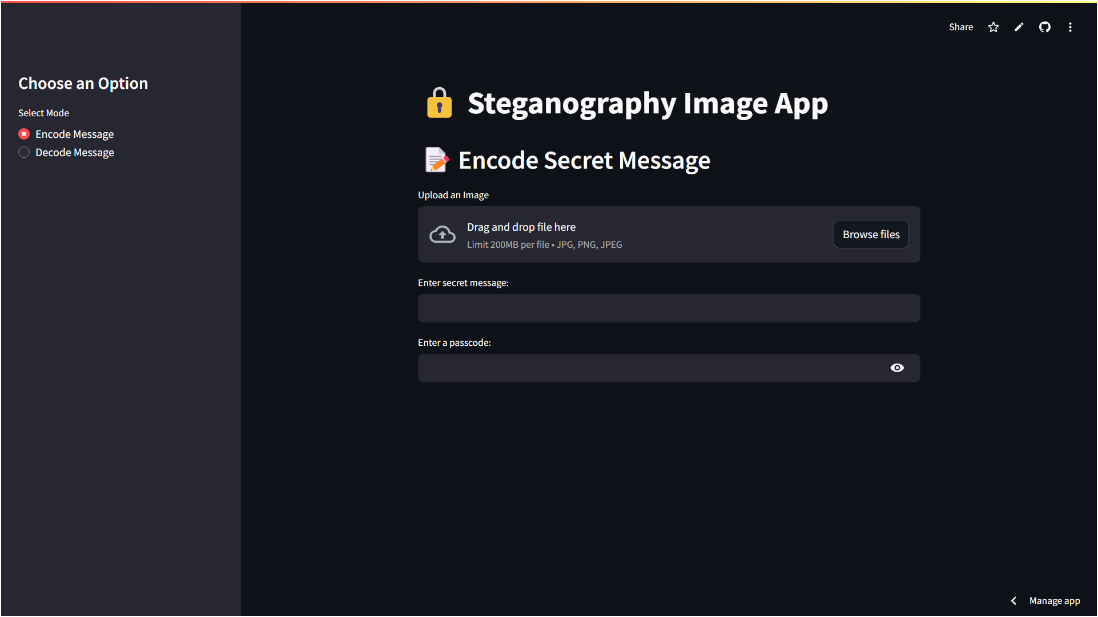
Results

Slide 9
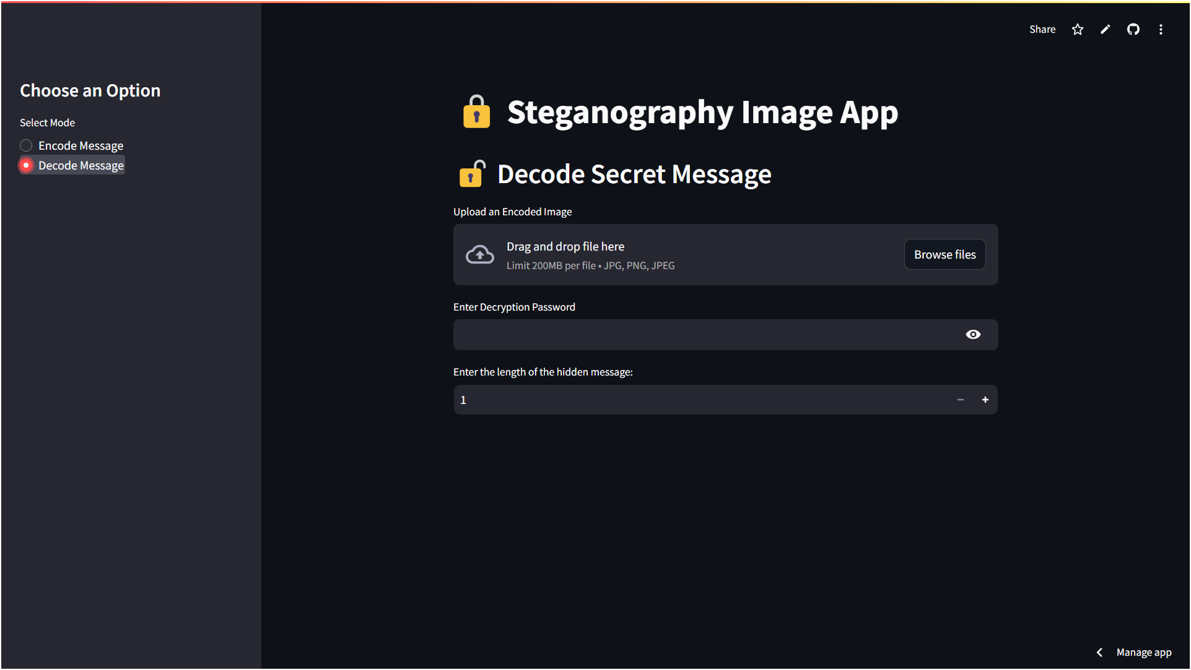
Results

Slide 10
Conclusion
This image Stenography App provides an innovative approach to data security by embedding secret messages within images. Unlike traditional encryption, it conceals the very existence of message, ensuring discreet communication. With an intuitive interface, strong security features, and no loss of mage quality, the app is a powerful tool for secure communication.

Slide 11
GitHub Link
https://github.com/jayasrineerukattu/aicte_cybersecurity

Slide 12
Future scope
Video Steganography: Extending functionality to hide messages within video files.
Audio Steganography: Embedding secrets within audio files for even more versatile usage.
Advanced Encryption Algorithms: Integrating stronger encryption methods for enhanced security.
Cloud Integration: Allowing users to store and share encoded images securely through cloud services.
Mobile App Development: Expanding accessibility with dedicated mobile applications for Android and iOS platforms.
AI Integration: Utilizing AI for enhanced image manipulation and undetectable steganography techniques.

Slide 13
THANK YOU

